Slide 1


Bank
Customer Churn
Analysis
Group Name :
THE BOYS
Samrat Halder
Sayan Mukherjee
Soumo Biswas
Krishanu Mukherjee
Piyush Meena

Slide 2

What is Bank Customer Churn ?
Bank customer churn, also known as customer attrition or customer turnover, refers to the phenomenon where customers of a bank stop using its services and switch to another bank or financial institution.

Slide 3

Why is Customer Churn Analysis important ?
Predicting and understanding churn is crucial for banks as it helps them identify at-risk customers and take proactive measures to retain them, thereby reducing revenue loss and maintaining a loyal customer base.

Slide 4

Customer Satisfaction
The objective of this project is to use machine learning techniques to build an accurate predictive model that can identify customers who are likely to churn from our bank's services. By analyzing historical customer data, including transactional behavior, demographic information, and customer interactions, our aim is to develop a model that can effectively forecast churn.
Objectives

Slide 5

EXPLORATORY DATA ANALYSIS

Slide 6
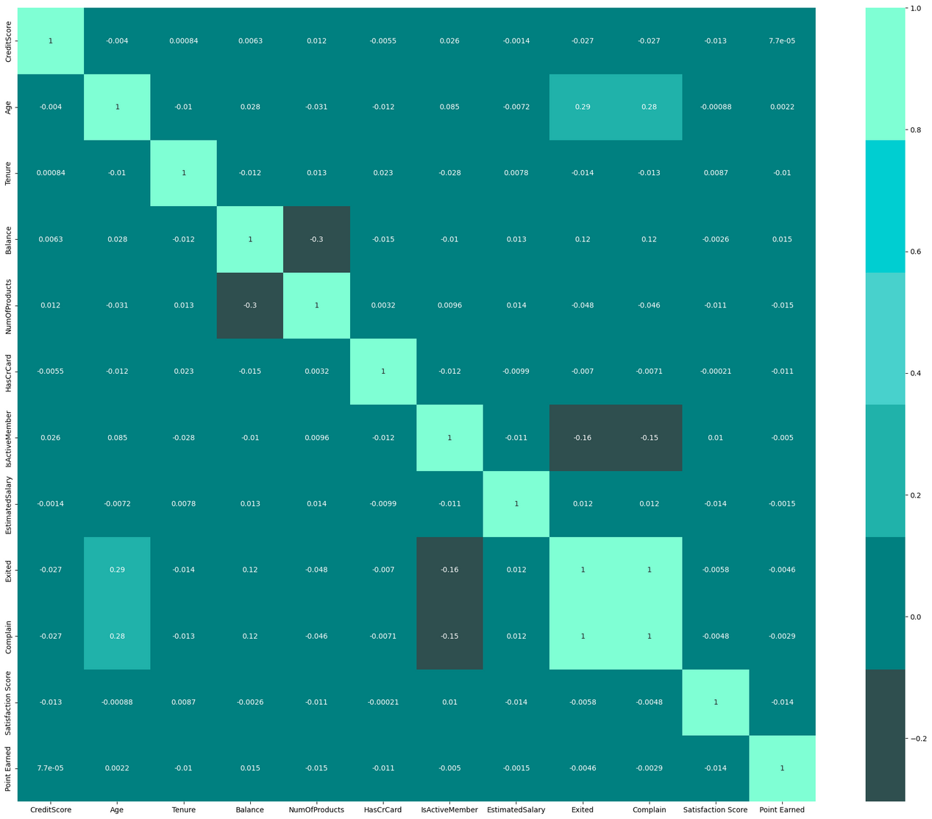

Correlation Matrix
A correlation matrix is a table showing correlation coefficients between variables, representing the strength and direction of their linear relationships.
From the table , we see that the correlation between exited and complain is 1. Thus we need to remove the complain variable from the dataset.

Slide 7
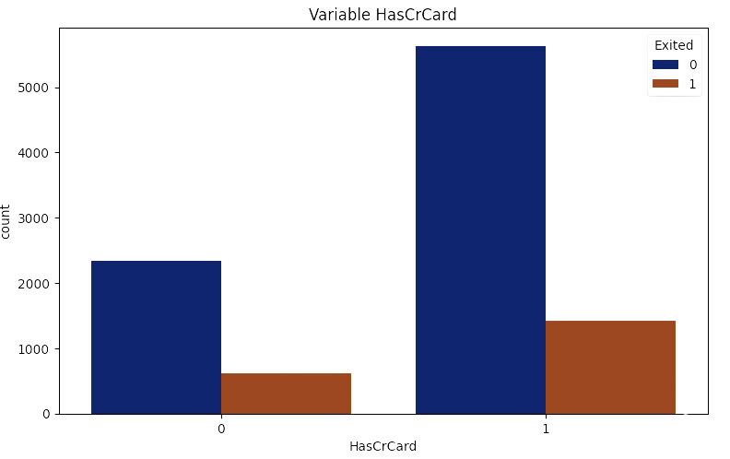
The left blue bar refers to customers who did not exit the bank. The height of the blue bar is around 5000, which means there are around 5000 customers who did not exit and have a credit card.
The right orange bar refers to customers who exited the bank. The height of the orange bar is close to zero, which means there are very few customers who exited the bank and have a credit card.

Slide 8
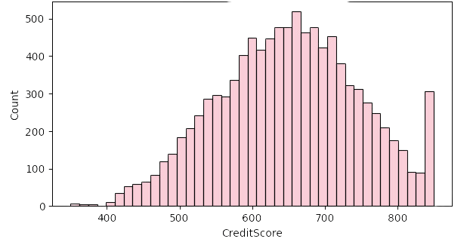
The most frequent credit score is around 640.
There are fewer people with very high credit scores (around 800) and very low credit scores (around 400).
The distribution appears to be bell-shaped, which suggests that the data may be normally distributed.

Slide 9
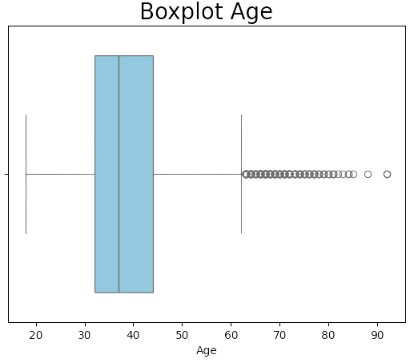
• The age of 50 percent customers lies between 32 to 44 approximately.
• The median of the Age of the customer is around 38.

Slide 10
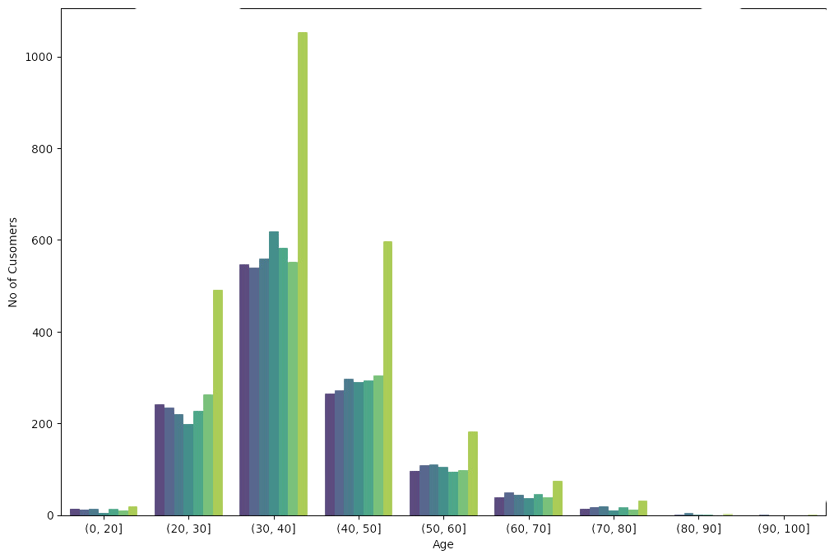
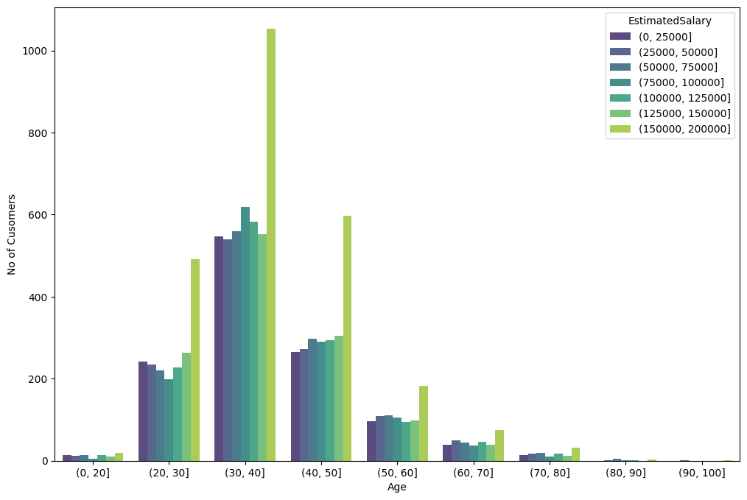
The age range appears to be between 20 and 100 years old.
There seems to be a peak in the number of customers around 40 years old. This suggests that there might be more customers in this age group than any other age group.
The data is grouped into bins. This means that the exact ages of the customers are not shown, but rather they are grouped into age ranges. For example, instead of showing the number of carriers at age 35, the graph might show the number of carriers between the ages of 30 and 39.

Slide 11

Logistic Regression

Slide 12

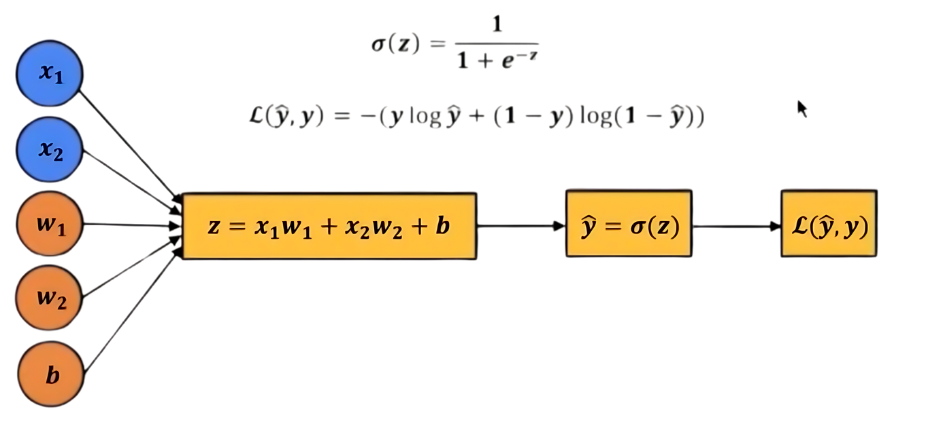


Logistic regression assumes that the relationship between the independent variables and the log-odds of the dependent variable is linear.
This model will help the bank identify customers at high risk of churning, allowing for targeted retention strategies.

Slide 13
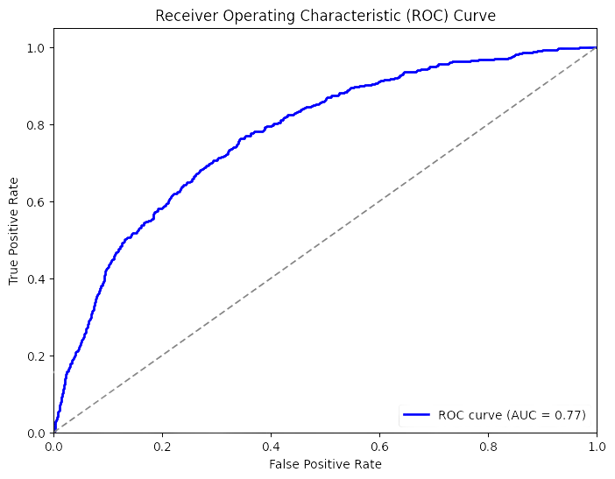
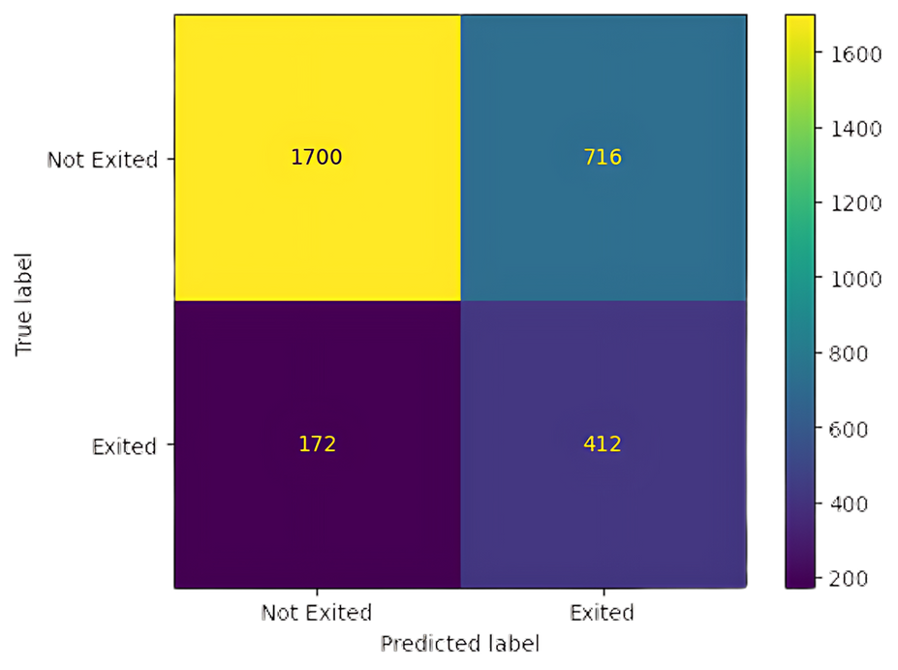


With an Area Under the Curve (AUC) of 0.77, the model demonstrates commendable discriminative ability in distinguishing between positive and negative cases.
From the confusion matrix, we obtain the Precision, Recall , Accuracy, F1-score of the model.

Slide 14
 | Precision | Recall | f1- score
0 | 0.91 | 0.70 | 0.79
1 | 0.37 | 0.71 | 0.48
Accuracy of Logistic Regression model 70% that means among the 30% of
the total data, for which we will predict the churn for a customer, our model
predicts True positives and True negatives are total 70% of that 30% data.

Slide 15
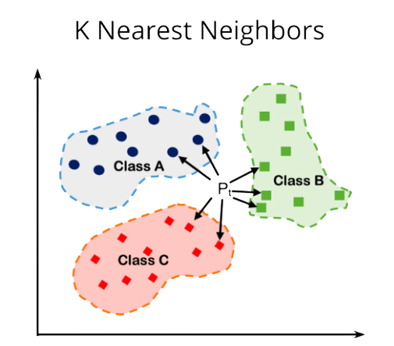
K - Nearest Neighborhood

Slide 16

KNN operates on the principle that similar data points are located close to each other in the feature space. It makes predictions for new data points by finding the K nearest neighbors based on a distance metric (e.g., Euclidean distance) and assigning the majority class (for classification) or averaging the values (for regression) of these neighbors.

Slide 17


 | Precision | Recall | f1- score
0 | 0.81 | 0.98 | 0.89
1 | 0.47 | 0.08 | 0.13
The accuracy of the model is 0.80, which means it gets 80% of the
predictions correct. However, this high accuracy is mostly due to the fact that
there are many more class 0 instances. The model performs poorly on the
minority class (class 1).

Slide 18

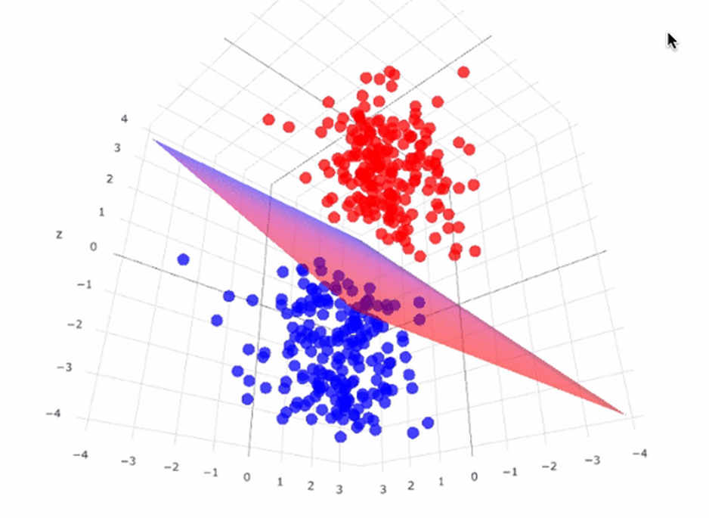
Support Vector
Machines

Slide 19

SVM works by finding the hyperplane that best separates the data points into different classes. The optimal hyperplane is the one that maximizes the margin, which is the distance between the hyperplane and the nearest data points (support vectors) from each class.

Slide 20
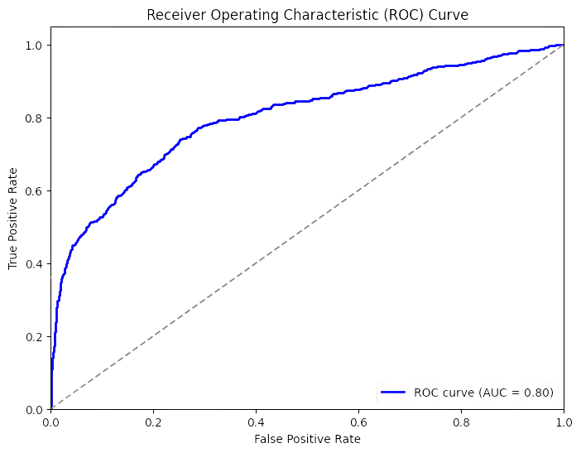
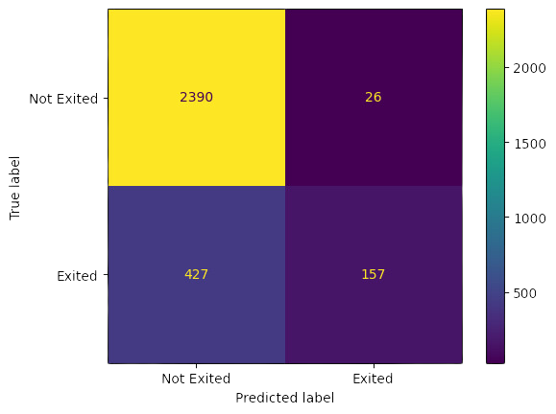


Confusion Matrix
ROC Curve

Slide 21
 | Precision | Recall | f1- score
0 | 0.85 | 0.99 | 0.91
1 | 0.86 | 0.27 | 0.41
The overall accuracy of the model is 0.849, which means that the model
correctly classifies 85% of the loan applications.

Slide 22
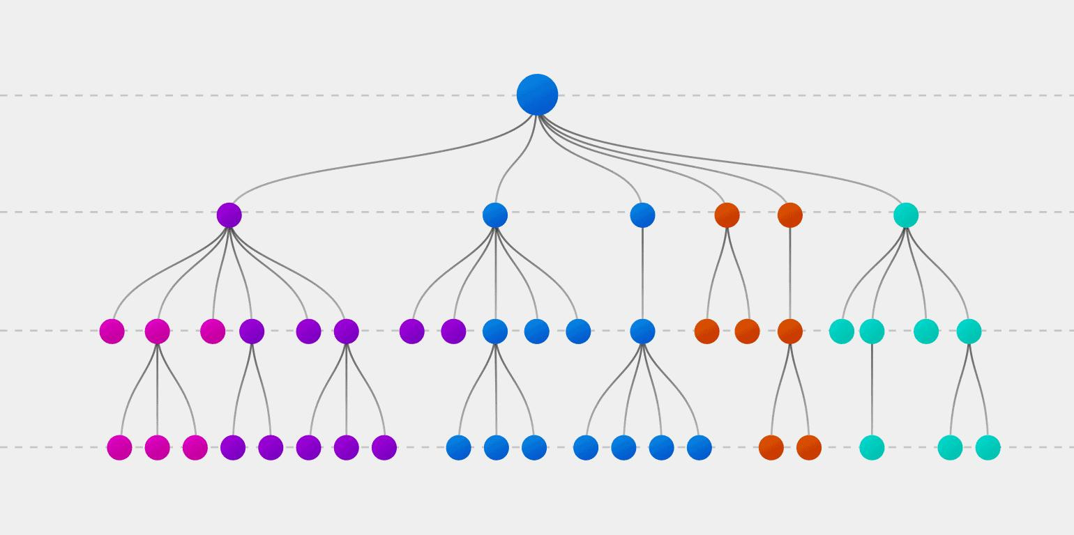
Decision Tree Classifier

Slide 23

The tree structure is built recursively, starting from the root node and splitting the data into subsets based on the feature that provides the best separation. This process continues until a stopping criterion is met, such as a maximum tree depth or minimum number of samples in a node.

Slide 24
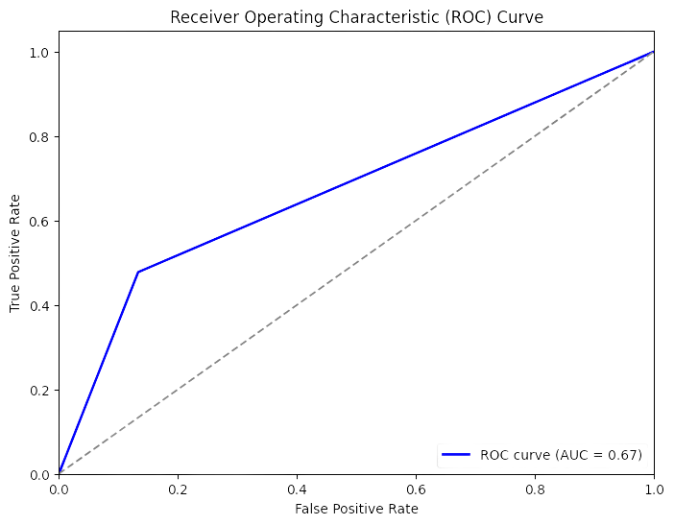

 | Precision | Recall | f1- score
0 | 0.87 | 0.87 | 0.87
1 | 0.46 | 0.48 | 0.47
ROC Curve
The overall accuracy of the model is 0.79, which means that the model correctly classifies 79% of the loan applications.

Slide 25
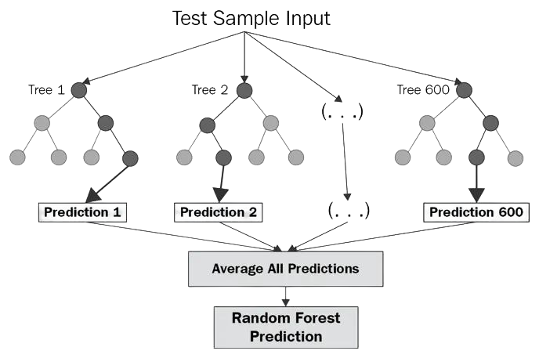

Random Forest

Slide 26

Instead of relying on a single decision tree, Random Forest builds a "forest" of trees by training each tree on a random subset of the training data and a random subset of the input features. This randomness helps to decorrelate the individual trees and reduce overfitting.
During prediction, each tree in the forest independently makes a prediction, and the final prediction is determined by aggregating the predictions of all trees. For classification tasks, this typically involves taking a majority vote, while for regression tasks, it involves averaging the predictions.

Slide 27
 | Precision | Recall | f1- score
0 | 0.89 | 0.94 | 0.92
1 | 0.68 | 0.54 | 0.60
The overall accuracy of the model is 0.86, which means that the model correctly classifies 86% of the loan applications.

Slide 28

Insights
Considering the geography, customer in Germany have the tendency to churn. Banks need to focus on improving facilities in Germany.
Older people (Age above 40) might need a better product or promotion such as better retirement plan, and higher interest rate on investment package.
Banks should focus on getting reliable customers, because a considerable amount of customers have credit score less than 700 (ideal score).

Slide 29
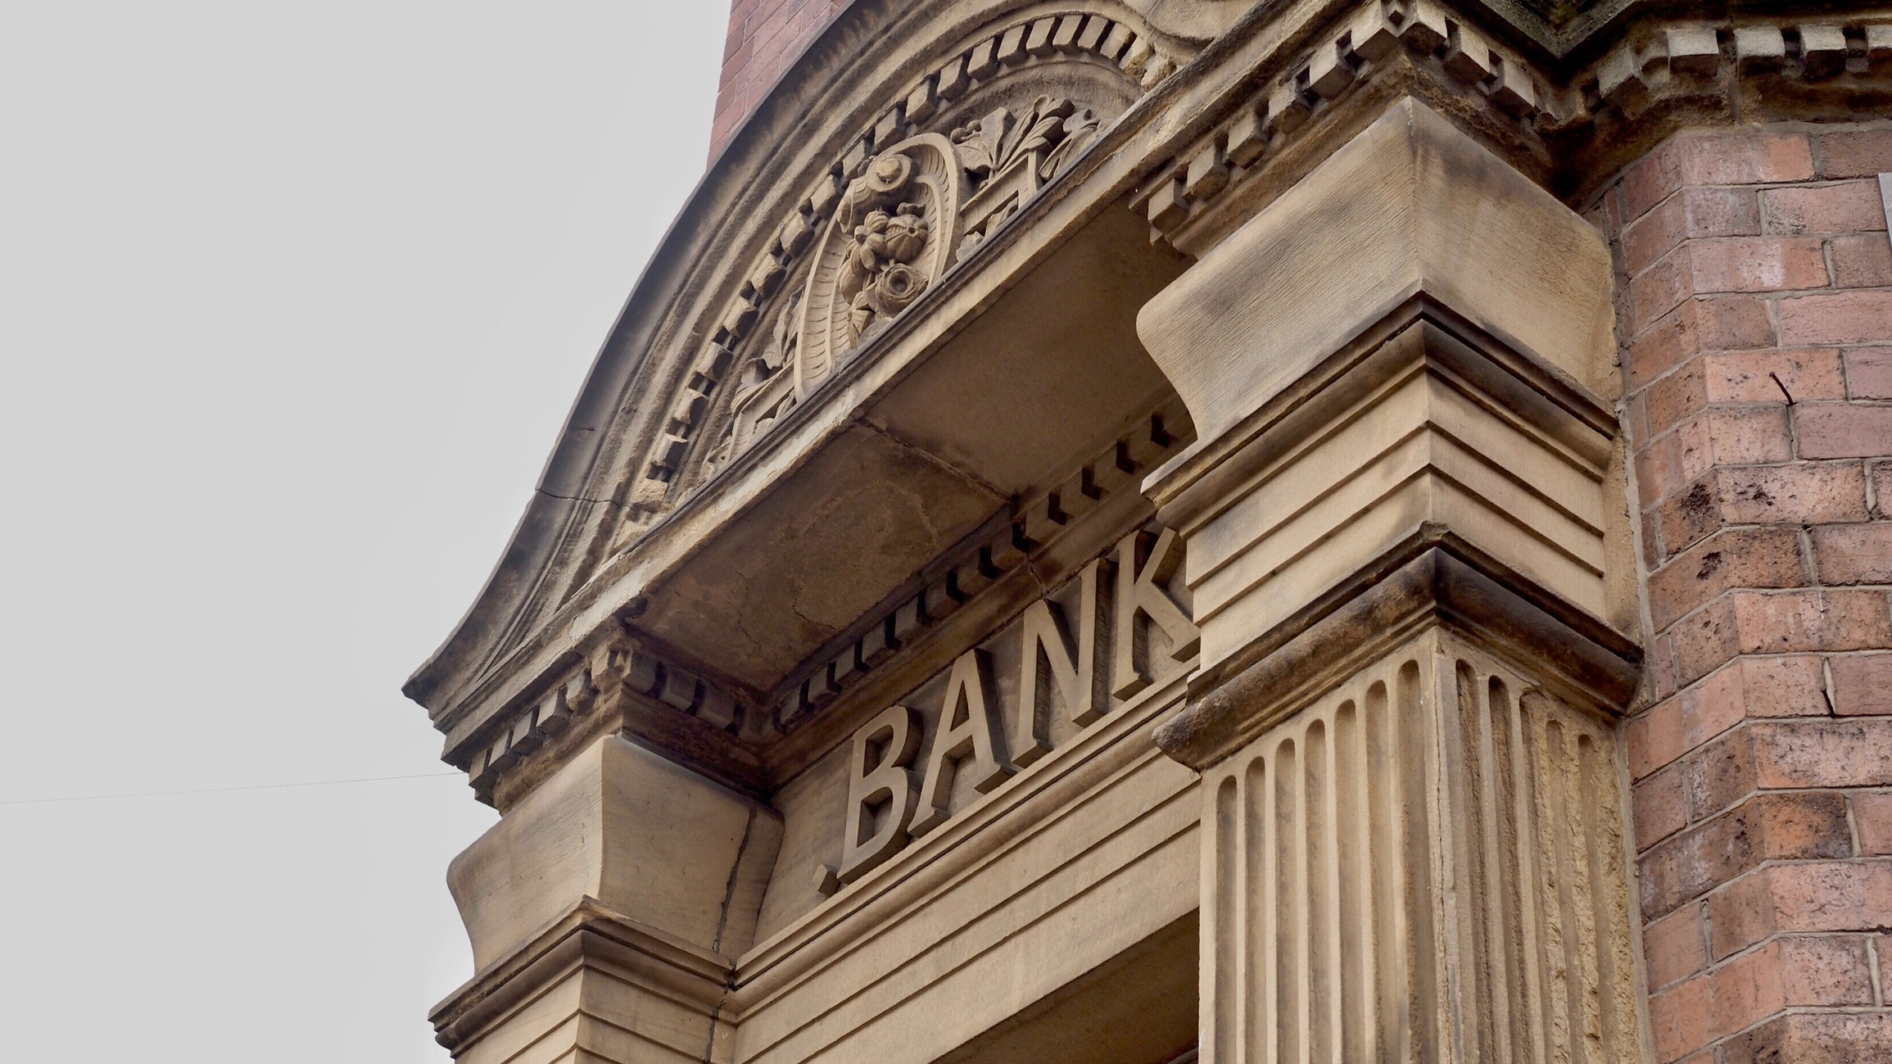
Conclusion
The analysis of a bank customer churn dataset highlights key factors affecting customer attrition, including credit score, geography, age, tenure, balance, product holdings, card usage, and customer activity.
Machine learning algorithms applied to the dataset allow the creation of predictive models for forecasting customer churn accurately.
After evaluating various machine learning algorithms, the Random Forest model demonstrated the highest accuracy. Its performance closely aligned with test values, indicating superior predictive capability compared to other algorithms. Therefore, the Random Forest algorithm is seemed the most suitable choice for the dataset, offering dependable and precise predictions.

Slide 30

Acknowledgements
We would like to express our sincere appreciation to Prof. Subhajit Dutta,
for his valuable guidance, support, and encouragement throughout this project.
We also thank the TAs for this course. Their guidance was invaluable in shaping
our work.
Additionally, we would like to thank IIT Kanpur for providing resources
and facilities that were essential for the completion of this project.
We are grateful for the opportunity to work on this project, as it has been
a great learning experience for all of us.
Lastly, we extend our thanks to our classmates and friends for their understanding
and encouragement during this project.

